Slide 1
comparison of methods
RF, SVR,(ELM),Deep Learning

Slide 2
Stability comparison
All the parameters are predicted separately.
Randomly separate the data into training and testing sets (20% for testing)
Input: Transforms features by scaling each feature to a range [0,1]
Output: Prediction results for single parameter (No normalization in order to keep interpretation)
X-axis: The maximum percentage of zero for each OUT
Y-axis: Root mean squared error

Slide 3
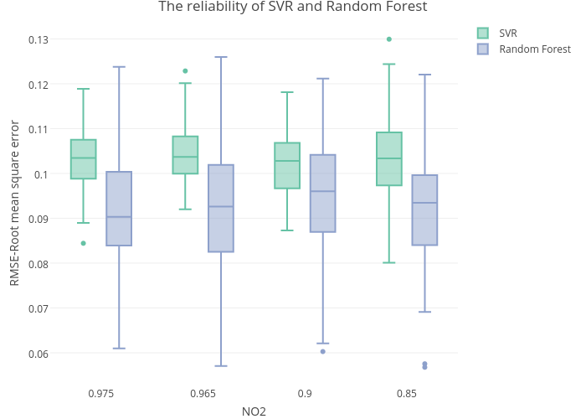
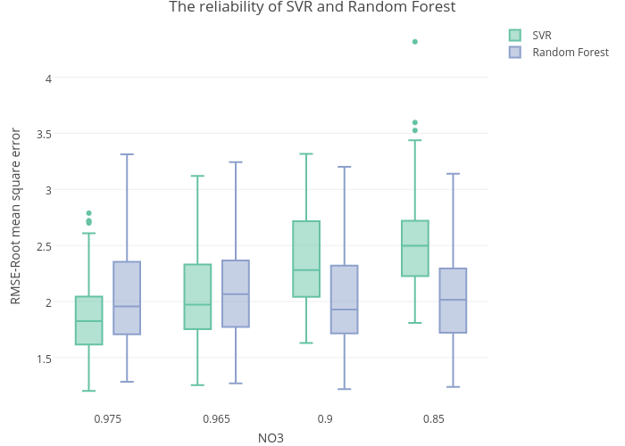
Examples (NO₂ & NO₃ & PO₄)

Slide 4
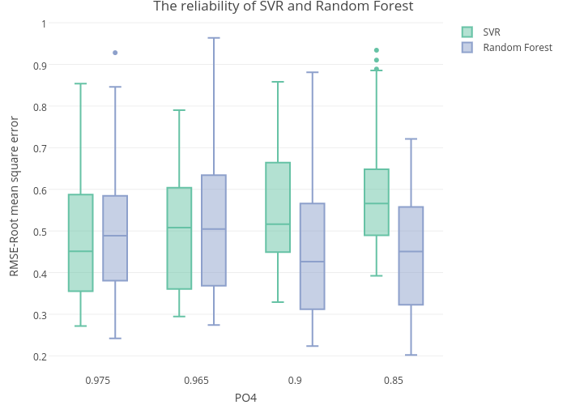
In most cases, SVR is more stable that RF.

Slide 5
Error rates comparison
Input: Normalized, range[0,1]
Output: Normalized, range[0,1] (It is better to compare all parameters at the same time)
X-axis: The name of parameter
Y-axis: Root mean squared error (RMSE)

Slide 6
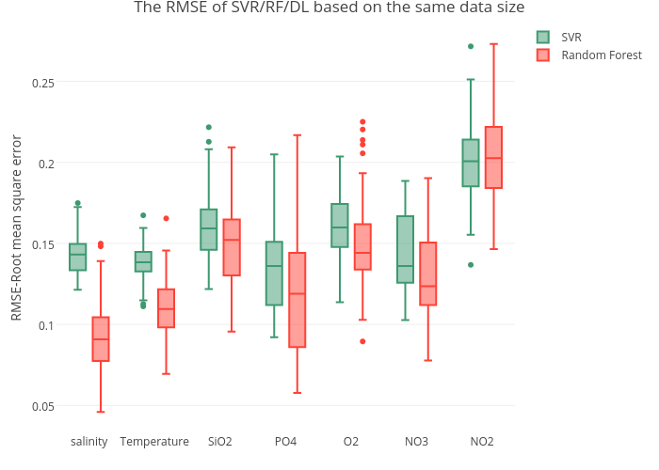
The accuracy of RF is better than SVR for most of parameters, but the variance is higher than SVR. Figure

Slide 7
How about DeepLearning?
Input: Normalized, range[0,1]
Output: Single parameter, NO Normalized (Good interpretation )
All algorithms use the same training set and testing set
X-axis: Real Value
Y-axis: Prediction

Slide 8
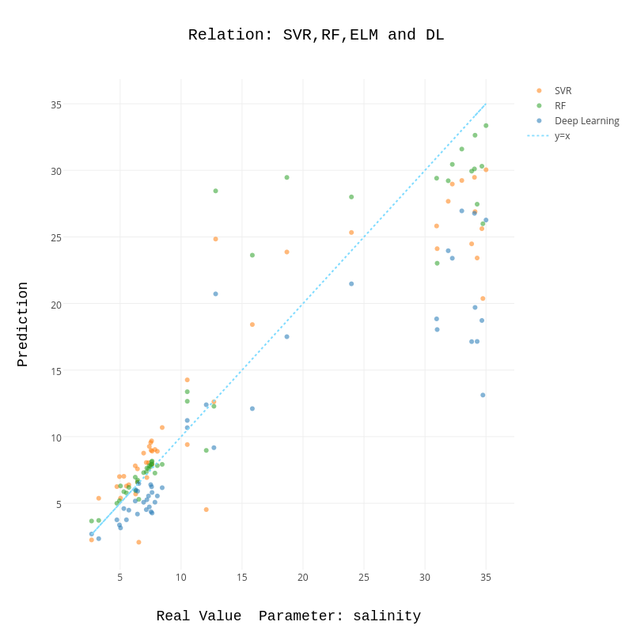
Different scopes have different performance. Low value segment: RF>SVR >DL Middle value segment: DL= SVR>RF Large value segment: RF>SVR>RF Figure

Slide 9
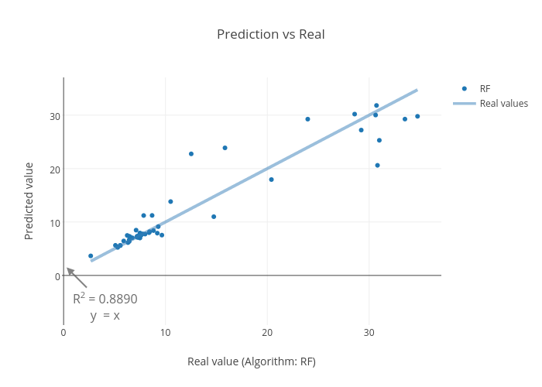
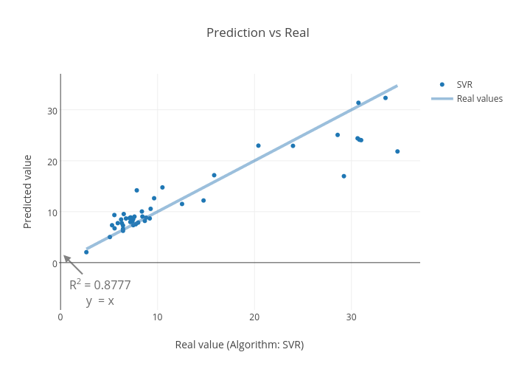
Regression function and Correlation coefficient for RF, SVR and DeepLearing

Slide 10
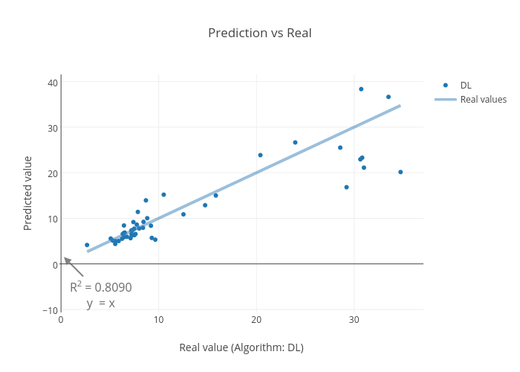
Zero percentage: 0.99 # OUT：5607

